Slide 1
Machine Learning Class 1
Aqib Ahmed

Slide 2


Slide 3
What is Machine Learning?
Machine learning is an application/function of artificial intelligence that provides systems the ability to automatically learn and improve from experience without being explicitly programmed

Slide 4


Slide 5
Rule based vs ML approach

Slide 6



Slide 7
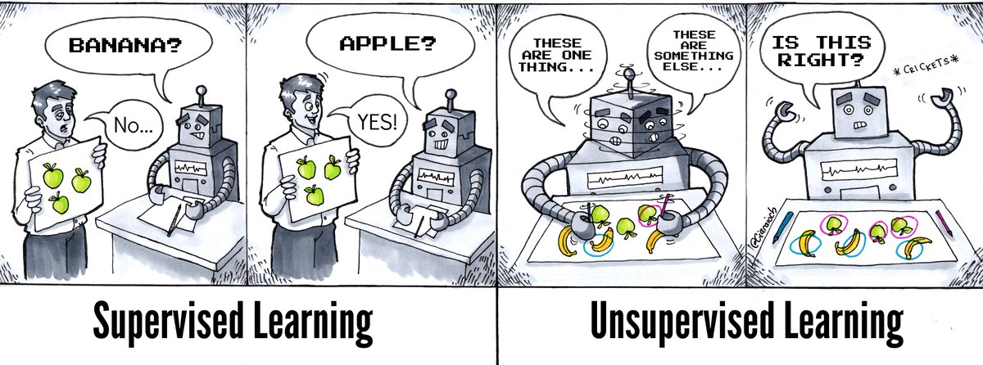

Slide 8
Supervised learning - Occurs when an algorithm learns from example data (target feature) Unsupervised learning - Occurs when an algorithm learns from plain data (Without target feature)

Slide 9
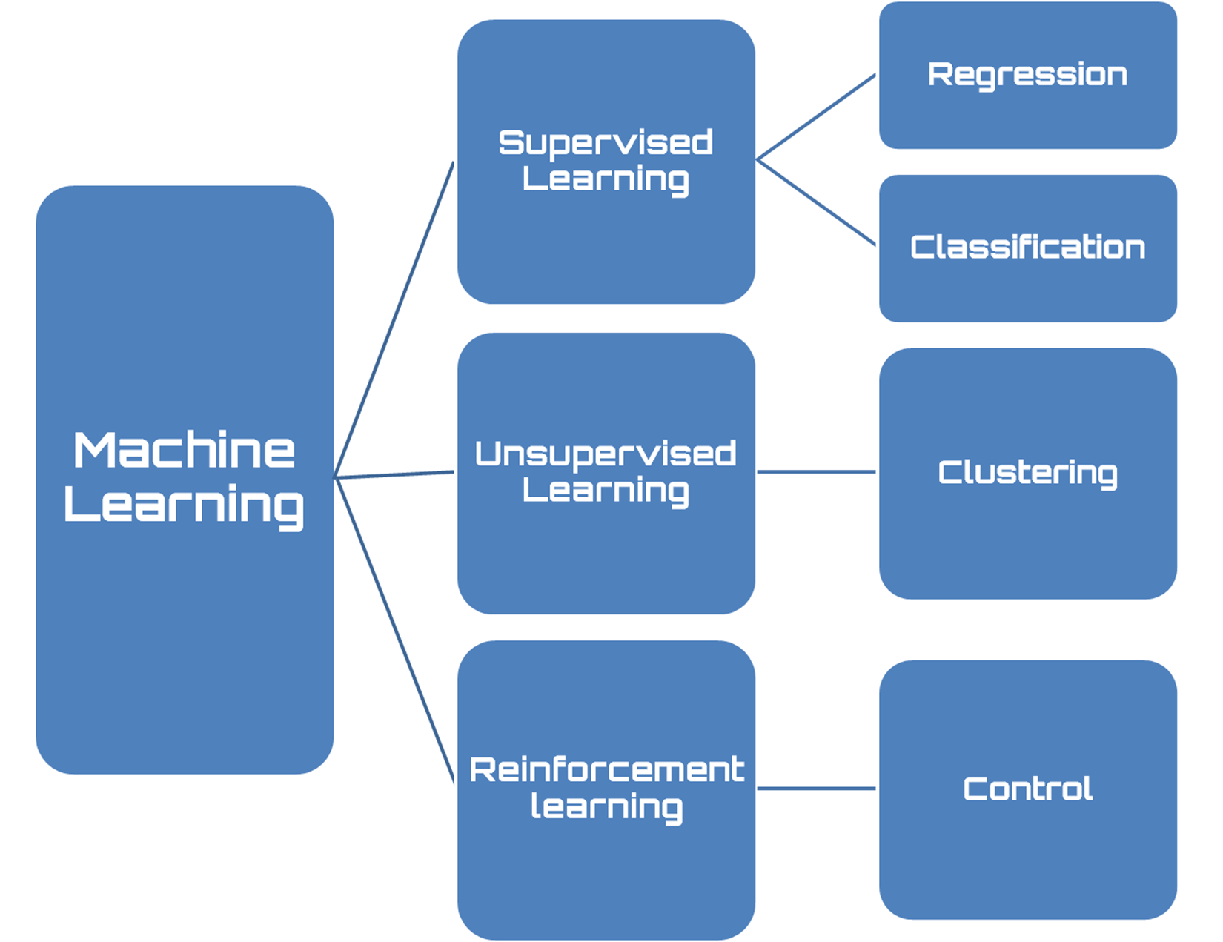

Slide 10
Subjects | Max marks | Passing Marks | Scored Marks
English | 100 | 35 | 70
Kannada | 100 | 35 | 90
Hindi | 100 | 35 | 75
Maths | 100 | 35 | 95
Science | 100 | 35 | 81
Social | 100 | 35 | 66
Subjects | Max marks | Passing Marks | Grades
English | 100 | 35 | B
Kannada | 100 | 35 | A
Hindi | 100 | 35 | B
Maths | 100 | 35 | A
Science | 100 | 35 | A
Social | 100 | 35 | B

Slide 11
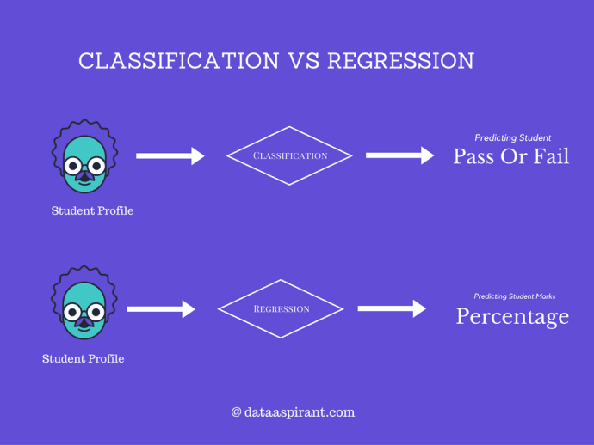

Slide 12
Regression - It is about predicting a quantity Classification - It is about predicting a label

Slide 13



Slide 14
Training and testing
Training set is the one on which we train and fit our model basically to fit the parameters whereas test data is used only to assess performance of model. Training data's output is available to model whereas testing data is the unseen data for which predictions have to be made.

Slide 15


Slide 16
Insurance : Age, Marital status, Employed, Height, Weight, School, College, Insurance Amount
Rainfall : Village/Town Name, Area, Temperature, Humidity, Date, Time, Soil, No of People, Rainfall
Telco : Customer Name, Location, Type, Data Usage, Height, Weight, Call Usage, Active/Inactive, Member since, No of complaints raised, Age, Churn
Gold rate : Item, Total Grams, Wastage, Stone weight, Date, Gold Rate

Slide 17
Feature Selection - Feature Selection is the process where you automatically or manually select those features which contribute most to your prediction variable or output in which you are interested in Feature Engineering - Feature engineering is the process of using domain knowledge to extract features from raw data

Slide 18
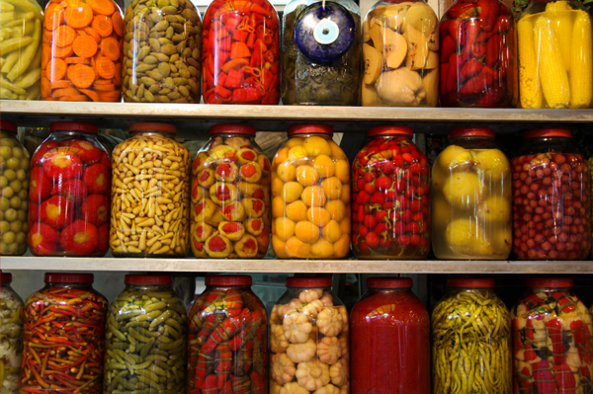

Slide 19
Pickling - Pickle is the standard way of serializing objects in Python

Slide 20
Assignment - Error Metrics

Slide 21

Thanks!

